Slide 1

Cloud Operations Transformation
The Cloud Operations Transformation engagement defines an transformation roadmap that unlocks the cost savings, business enablement, and agility that Cloud can enable for your organization. During this engagement, we help you plan, transition, and execute a cloud-enabled operating model to effectively run a cloud and/or hybrid environment. AWS ProServe and your operations leadership will work together to align your people, processes, and tooling with your IT and business goals.
Key Activities:
Conduct evaluation of current environment across enterprise operations and applications
Understand cloud and/or hybrid operations desires by organization
Perform a gap analysis between current and future state cloud operations
Assess operational accountabilities and associated skill sets
Outcomes:
Cloud Operations Model Recommendations
Recommended Cloud Team Design
Cloud Role and Skill Gap Analysis and Roadmap Creation
Creation of an Operational Playbook (detailed below)
Facilitation of an Operational Runbook (detailed below)
Operations RACI Template

Slide 2
Cloud Operations on AWS Playbook
The Cloud Operations on AWS Playbook offering is designed to help your team through the decision process of designing and documenting your operational strategies and procedures necessary to manage your applications on AWS. This offering addresses the “what”, “why”, and “how” surrounding hybrid cloud operations on AWS.
Key Activities:
Discuss your current IT operations strategies, including incident management, patch management, backup & restore, disaster recovery, request management, etc.
Review best practices and approaches for operating applications on AWS
Introduce tools, capabilities, and procedures used in managing applications that promote agility, cost reduction, and innovation
Outcomes:
Understanding of cloud operations, management tooling, and AWS service options
Cloud Operations Playbook detailing the core operational capabilities and tooling necessary to efficiently operate applications on AWS
Operations team design and RACI detailing roles/responsibilities
Identified roadmap for future activities to mature operational approach

Slide 3
Cloud Operations on AWS Runbook
This Cloud Operations Runbook offering helps design and implement guidelines and procedures to enable automation and efficiently manage operation processes throughout the lifecycle of production workloads.
Key Activities:
Discuss current IT strategy and operations processes, including incident management, change management, patch management, backup & restore, disaster recovery, request management, etc.
Define a list of processes for inclusion in the runbook
Identify opportunities for automation to improve efficiency
Prepare a runbook for defined processes used in managing applications and infrastructure that promote agility, cost management, and innovation
Outcomes:
Defining processes of IT operations based on customer requirements
Providing the runbook and implementing the automation and process integration including code snippets
Facilitated design of your cloud operations on AWS Runbook

Slide 4
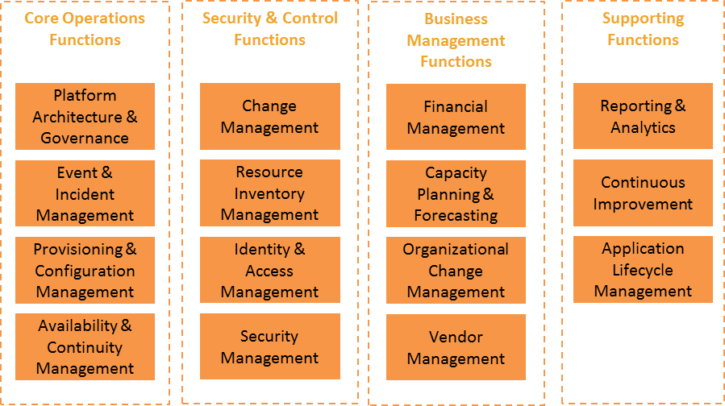
Operational functions needed to be covered

Slide 5
Example of a playbook strategy table… created for each of the 15 operational functions
Define traditional and target model approach
Define AWS-specific roadmap
Activity | Traditional Approach | Target Model
Event Monitoring | SNMP traps via proprietary network management systems (e.g. HP OpenView) that are difficult to customize and automate. If managed by MSP, details are not shared with customers unless they use the same network management system or pay for integration. Customers notified by outbound case/email. Engineers must investigate all events to determine if there is an incident | Monitoring performed by monitoring tool of choice using metrics, thresholds, and multi-metric event detection. Integration of events and incidents to other enterprise IT tools is easy with published APIs and pre-built plugins. Proactive scripts launch workflows that can handle known events automatically; meaning, incidents become an anomaly and are actually worthy of an engineer’s time to investigate. If customers do need to be notified, they are done so by the contact method of their choice (email, HTTP, SMS).
 | Shortcomings: Human intervention necessary to determine if events are really incidents; increases cost and slows response and escalation | Advantages: Increased productivity and resolution rates of incidents by engineers due to self-healing automation. Implementation of a continuous monitoring method improves your security posture and enables anytime measurement of your resources against internal and/or regulatory compliance. Increased ability to perform meaningful forensics on incidents due to improved visibility into point-in-time configuration changes and a complete data stream of API-call logging.
Target Model implemented on AWS
With AWS, monitoring tools are available to monitor and alert regarding AWS services. These tools can be accessed directly through the AWS Console or via API, which can be routed to Shell’s enterprise monitoring tool of choice AWS’s many services and deployment flexibility options result in applications being classified more granularly according to its true uptime and retention needs. Launching this applications on AWS using innovative architecture recommendations like Pilot-light and Warm-standby, results in every application being able to afford at least some level of easy recoverability. In addition, Business Critical applications that require multi-site redundant infrastructures for maximum uptime can take advantage of the global dispersion of AWS regions, network, and edge locations, currently operating on all six major continents.

